Slide 1
Position Sensors
DR. JESUS-Arturo Escobedo-CABELLO

Slide 2
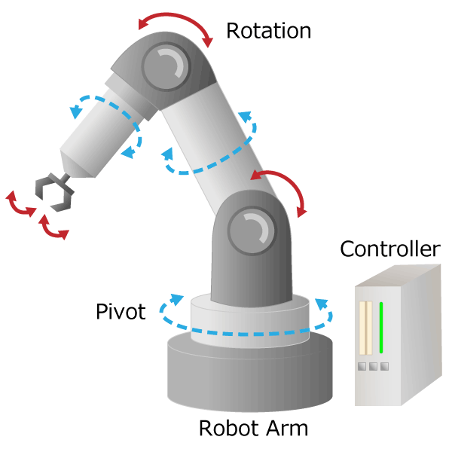
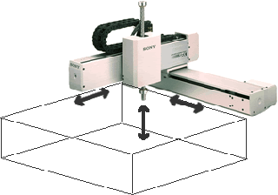
Position Sensors
They are some of the most common sensors used in robotics (after voltage, resistance and current meters).
We frequently need to know the position of different parts of the system.
Position sensors can measure either angular or linear displacements.
Angular Position Sensors
Linear Position Sensors
Joints
Tool
In robotics, we need to measure the position of each joint to know where the tool is
Notes:
Las imágnes de este slide podrían ser útiles para el tema de range sensors

Slide 3
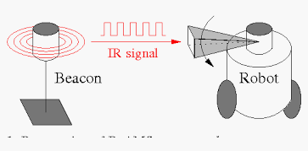
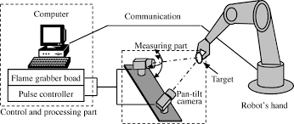
Position Sensors
They are some of the most common sensors used in robotics (after voltage, resistance and current meters).
We frequently need to know the position of different parts of the system.
Position sensors can measure either angular or linear displacements.
Angular Position Sensors
Linear Position Sensors
BeAMS: A Beacon-Based Angle Measurement Sensor for Mobile Robot Positioning
https://www.tytlabs.com/english/review/rev382epdf/e382_043matsubara.pdf
Notes:
En robótica, uno de los tipos más utilizados de sensores son de posición.
Esto es debido a que multiples aplicaciones requieren la medición de la distancia del robot con respect a los objetos de su entorno (por ejemplo para poder evader obstáculos)
O bien, si pensamos en un brazo manipulador podríamos imaginar cualquier cantidad de aplicaciones en las cuales nos será necesario poder medir la distancia a un determinado objeto para tomarlo.
Los sensors de posición pueden medir ya sea distancias lineales o angulares.
Vamos a comenzar con sensors que nos sirven para medir ángulos.
(NEXT)

Slide 4
Notes:
One of the cheapest solutions we can use to measure displacements are potentiometers.

Slide 5
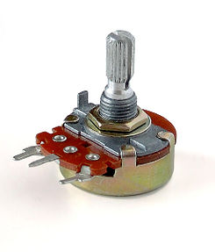
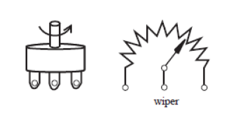
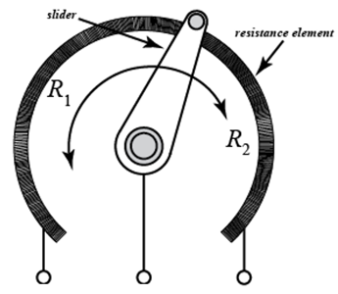

Potentiometers
A potentiometer is a manually adjustable, variable resistor with three terminals.
Two terminals are connected to a resistive element, the third terminal is connected to an adjustable wiper.
The measurement is obtained by moving a slider on a resistive track, which, will give a proportional value in resistance depending on its location.
Wiper/
slider
An angular potentiometer used to measure rotational displacements
Notes:
http://www.resistorguide.com/potentiometer/
A potentiometer is a manually adjustable, variable resistor with three terminals.
Two terminals are connected to a resistive element, the third terminal is connected to an adjustable wiper.
The position of the wiper determines the output voltage.
Resistance and resistivity
http://hyperphysics.phy-astr.gsu.edu/hbase/electric/resis.html
𝑅=𝜌𝐿/𝐴

Slide 6
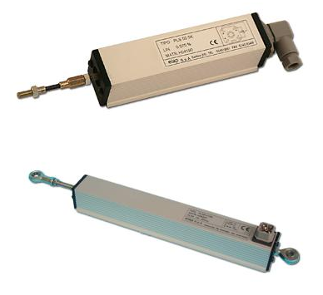
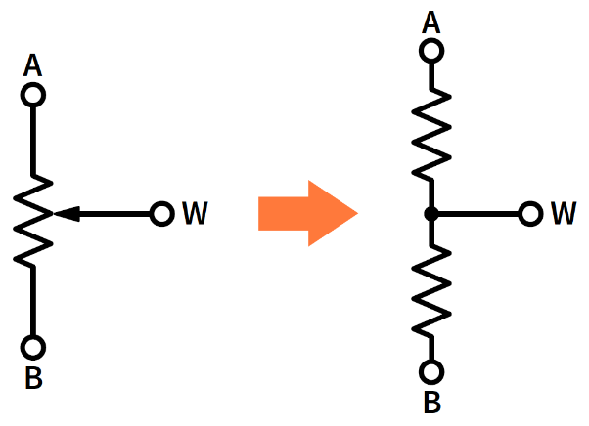
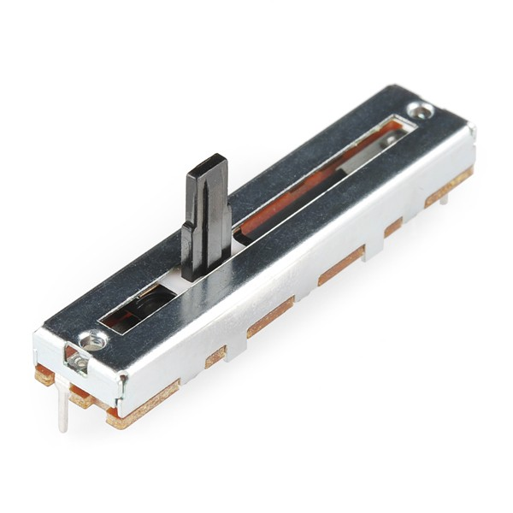


Linear potentiometers
We can also use potentiometer to measure linear displacements.
The working principle is the same as for the angular potentiometers. Typical linear potentiometers have a range up to tens of centimeters.
(Left) Electrical Symbol of a Potentiometer. (Right) Equivalent circuit.
Notes:
Linear potentiometers are distance and position sensors with contact and friction. The measurement is obtained by sliding a brush on a resistive plastic track, which, depending on the point where it is located, will give a proportional value in resistance. Resistance values of 1k, 2k, 5k and 10k are the most common. They can measure small displacements of up to tens of centimeters.

Slide 7
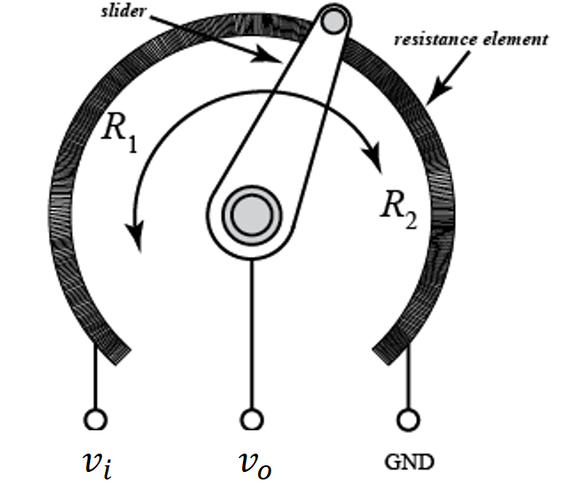
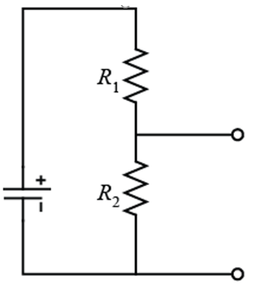





Potentiometer as voltage divider
Notes:
The slider internal to the potentiometer breaks the wound resistance into two halves, and .
The slider or wiper is attached to a shaft that is attached to the pendulum. As the pendulum swings, the slider moves changing the distribution of the total resistance between and . By applying voltage across the total wound resistance, the potentiometer behaves like a voltage divider. Hence the output voltage changes as changes.
𝑣𝑜/𝑣𝑖=𝑅_2/(𝑅_1+𝑅_2 )

Slide 8
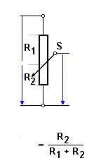

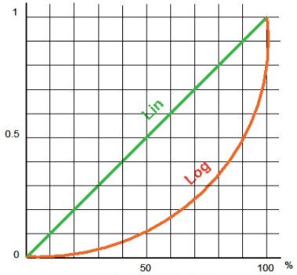



Different characteristic curves
Slider position (%)
Notes:
http://www.sengpielaudio.com/calculator-voltagedivider.htm
The most popular type of variable resistor and potentiometer is the linear type, or linear taper, whose resistive value at pin 2 varies linearly when adjusted producing a characteristics curve that represents a straight line. That is the resistive track has the same change of resistance per angle of rotation along the whole length of the track.
So if the wiper is rotated 20% of its total travel, then its resistance is 20% of maximum, or minimum. This is mainly because their resistive track element is made from carbon composites, ceramic-metal alloys or conductive plastics type materials which have a linear characteristic across their whole length.
But the resistance element of a potentiometer may not always produce a straight line characteristic or have a linear change in resistance across its whole range of travel as the wiper is adjusted, but instead can produce what is called a logarithmic change in resistance.
https://www.electronics-tutorials.ws/resistor/potentiometer.html
The S-curve or sigmoid function is 𝑆(𝑥)=1/(1+𝑒^(−𝑥) )=𝑒^𝑥/(𝑒^𝑥+1)
May potentiometers are designed so that when they are used in a voltage divider circuit the movement of the slider produces a certain characteristic curve. Here we have some of the possible characteristic curves. Notice number 4 which is able to give us a linear relationship between the input and the output voltage.
When the potentiometer resistance is decreased (the wiper moves downwards) the output voltage from pin 2 decreases producing a smaller voltage drop across R₂. Likewise, when the potentiometer resistance is increased (the wiper moves upwards) the output voltage from pin 2 increases producing a larger voltage drop. Then the voltage at the output pin depends upon the position of the wiper with this voltage drop value subtracted from the supply voltage.

Slide 9
Advantages and disadvantages
Advantages:
Low cost
Easy to use
Simple technology
Disadvantages:
Wear of moving parts.
Low precision
Friction
Range limited to a certain number of turns.
Notes:
Disadvantages:
Wear of moving parts.
Low precision
Friction
Range limited to a certain number of turns (the simplest gives 1 turn between 0 ° and 330 °)
Advantages:
Low cost
Easy to use
Simple technology

Slide 10
Problem
A 270º single-turn 1.5kΩ carbon track rotary potentiometer in a voltage divider configuration provides an output of 6 volts from a 9 volt battery power supply. (Assume a linear calibration curve) Calculate,
The angular position of the wiper on the track in degrees and.
The values of the resistances either side of the wiper.
Notes:
Click next for the next slide
https://www.electronics-tutorials.ws/resistor/potentiometer.html
Then the wipers angular position is 180º or 2/3^{rds} rotation.

Slide 11
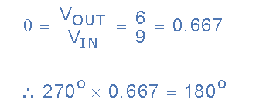
Problem
A 270º single-turn 1.5kΩ carbon track rotary potentiometer in a voltage divider configuration provides an output of 6 volts from a 9 volt battery power supply. (Assume a linear calibration curve) Calculate,
The angular position of the wiper on the track in degrees and.
The values of the resistances either side of the wiper.
1)
Notes:
Then the wipers angular position is 180º or 2/3^{rds} rotation.

Slide 12
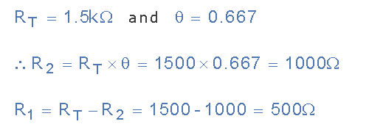
Problem
A 270º single-turn 1.5kΩ carbon track rotary potentiometer in a voltage divider configuration provides an output of 6 volts from a 9 volt battery power supply. (Assume a linear calibration curve) Calculate,
the angular position of the wiper on the track in degrees and.
The values of the resistances either side of the wiper.
2) Potentiometer Resistance Values:
Notes:
Then the wipers angular position is 180º or 2/3^{rds} rotation.

Slide 13
References
(Usher1996) M. J. Usher and D. A. Keating, Sensors and transducers: characteristics, applications, instrumentation, interfacing (Macmillan, London, UK, 1996).
(Gopel1991) W. Göpel, J. Hesse, and J. N. Zemel, Sensors: A Comprehensive Survey (VCH, Weinheim, Germany, 1991).
(Alciatore2011) D.G Aliciatore, Introduction to Mechatronics and Measurement Systems, 4th Edtition, (McGraw-Hill, 2011).
(Kalantar2008) K. Kalantar, Nanotechnology-Enabled Sensors, (Springer, 2008).
(DeSilva2016) C.W De Silva, Sensor Systems, fundamentals and applications. (Taylor and Francis 2016).

